Slide 1

Open Data Kit (ODK) 2.0: A Services-Based Application Framework
Submitted By :- Rohan (241110057)
Course :- CS724
Prof. Dr. Amitangshu Pal

Slide 2
Open Data Kit (ODK) 2.0: A Services-Based Application Framework Disconnected Data Management in Resource-Constrained Environments
Waylon Brunette, Samuel Sudar, Mitchell Sundt, Clarice Larson, Jeffrey Beorse, Richard Anderson
Department of Computer Science and Engineering
University of Washington

Slide 3
Introduction
Increasing use of mobile devices in 3 sectors.
Resource constrained communities.
Challenges due to limited internet connectivity and technical expertise.
Organization focus on improving 3 sectors in under-served communities.
Importance of disconnected operation in mobile applications.
Notes:
2/3 population,

Slide 4
Problem
Over two-thirds of the global population owns mobile phones, but less than half are connected to the Internet.
Limitations of existing mobile frameworks: Existing mobile frameworks are not well suited for offline data management.
Designed for short periods of disconnection: Data collection relies on stable internet, but underserved communities lack connectivity.
Require significant technical skills: Existing solutions need descent level of technical expertise to operate them.
Organizations need a solution that is easy to use and adapts to these challenges.
Notes:
2/3 population,

Slide 5
Solution: Open Data Kit (ODK) 2.0
ODK 2.0 is a modular application framework designed.
It aims to address these gaps by enabling data collection and management in disconnected environments.
Designed for organizations with limited technical capacity enabling mobile data solutions.
Suitable for users with disconnected data management ion offline environments.

Slide 6
ODK 1.x
Limited Workflow Flexibility: ODK 1.x primarily supports linear workflows, making it less effective for complex data collection processes.
One-Way Data Flow: Data collected in the field can’t be updated or modified after initial collection, limiting its use for longitudinal studies.
Basic Offline Support: Offline functionality is limited, with minimal caching, making it challenging for long-term disconnected use.
Limited Customization: Requires technical expertise to adjust forms and workflows, restricting non-programmers from easily customizing applications.
Security Constraints: User permissions are limited, making it hard to control data access in multi-user environments.

Slide 7
ODK 2.0 Core Components
ODK 2.0 include six modular components designed to handle data collection, synchronization and management.
Each component serves a distinct purpose and collectively provides a complete offline data management solution.
Key Features:
Customizable mobile data management solution model.
Flexible abstractions for varying technical skill levels.

Slide 8
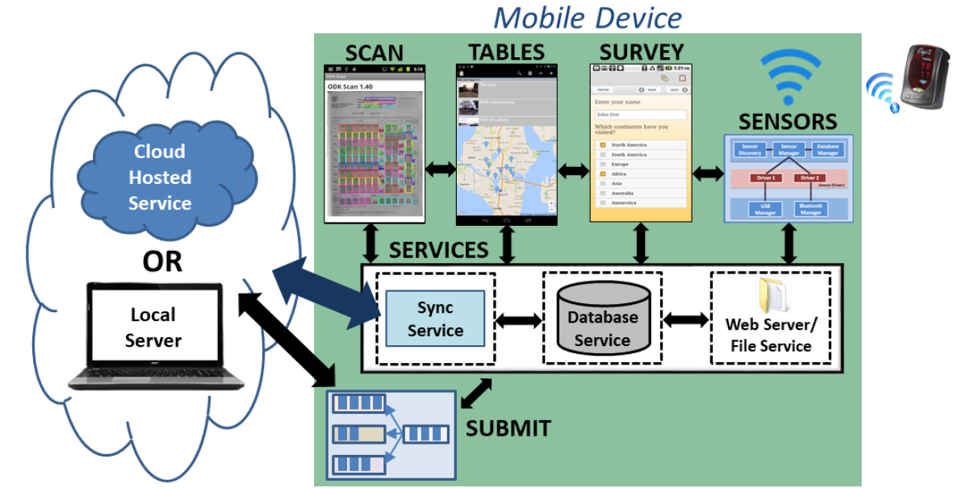
ODK 2.0 Core Components

Slide 9
Core Components (Part 1)
Survey: Collects data using customizable forms.
Tables: Provides data management and display.
Scan: Supports digitization of papers forms.
Sensors: Integrates data from external hardware sensors.
Services: Synchronizes data, manages user permissions and consolidates backend operations.
Submit: Allows data transfer across devices with various networking operations.

Slide 10
Design Considerations
ODK 2.0 was designed to provide flexible and resilient data management for offline, low-resource environments.
Key principles focus on simplicity, offline functionality and ease of customization.
Focus on usability for non-programmers:
Simplified user interface elements.
Basic data structures that are easy to manage.
Adaptability to extreme networking conditions.

Slide 11
Design Considerations
Flexibility: Customizable data forms, interfaces, and workflows.
Simplicity: Uses JavaScript for easier modifications by non-technical users.
Security: User and group-based permissions to control data access and protect sensitive data.
Offline Operation: Supports long periods without internet, enabling local data storage.
Efficiency: Reduces bandwidth and syncs data when a connection is available.
Extensibility: Modular design allows users to add or customize components as needed.

Slide 12
Case Studies
ODK 2.0 has been deployed in diverse scenarios worldwide. Here are some notable examples:
Each example highlights unique ways ODK 2.0 adapts to various field requirements.
Childhood Pneumonia: Assists health workers with diagnosis workflows.
Chimpanzee Behavior Tracking: Replaced paper forms with real-time tracking.
HIV Clinical Trial: Used to manage patient records across multiple sites.
Disaster Response (Red Cross): Tracked beneficiaries during disaster relief.
Mosquito Infection Tracking: Supported disease tracking across locations.
Tuberculosis Patient Records (Mercy Corps): Digitized TB patient records in rural clinics, improving data accuracy and tracking.

Slide 13
Challenges & Future Improvements
ODK 2.0 is effective but faces certain challenges:
Handling frequent data model changes in dynamic environments.
Balancing scalability with limited infrastructure.
Data Model Flexibility: Frequent model changes can be challenging.
Long-Term Storage and Analysis: Row-based storage simplifies analysis but limits frequent updates.
Future work could focus on better handling of data model updates.

Slide 14
THANK YOU

